Slide 1


Social Media Web App Presentation
Project Team:
Abdelkerim Taleb Ould Sidi
Notes:
Photo by Fezbot2000 on Unsplash

Slide 2

1
Introduction to the idea
2
How we will target users
3
Design of the app
4
Path used to code the app
5
Screenshots form the app
Notes:
Photo by Nik MacMillan on Unsplash

Slide 3
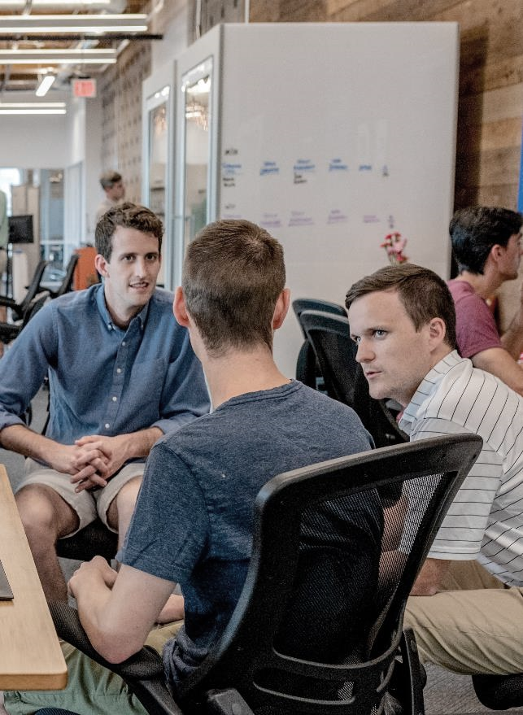
The main idea of the app is to provide a platform in which new students could meet or get to know classmates even before classes start, also to give them the opportunity to get to know students who already passed or are in final years of the same field of study so they could use their knowledge and experience to better prepare themselves
Introduction

Slide 4
It will also help students acquire lectures and archives of previous years in the archive section of the app and be aware of upcoming events in their or in another university
Introduction

Slide 5
How we will target users
Identify our target audience’s demographic
Develop a hypothesis
Implement changes
Conduct market research
Build user personas
Analysis

Slide 6
https://drive.google.com/drive/folders/1D9JXtI5Wu7LUpxw9BGNH6V75iYshAkzz?usp=share_link
Design

Slide 7

Path used to code the app
CSS3
Style sheet language used for describing the presentation of a document written in a markup language such as HTML or XML
HTML5
JAVASCRIPT
The standard markup language for documents designed to be displayed in a web browser
Programming language that is one of the core technologies of the World Wide Web

Slide 8
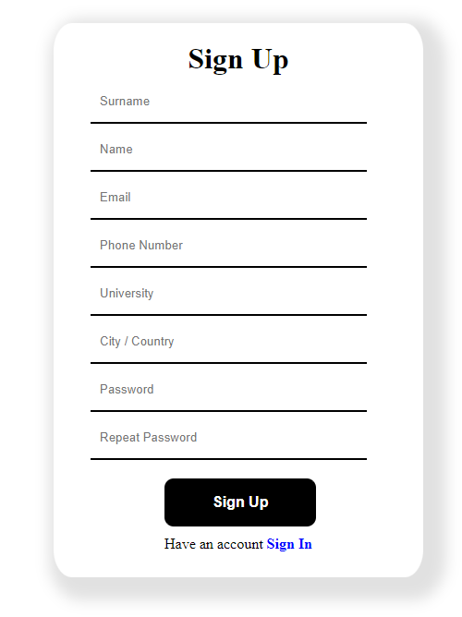
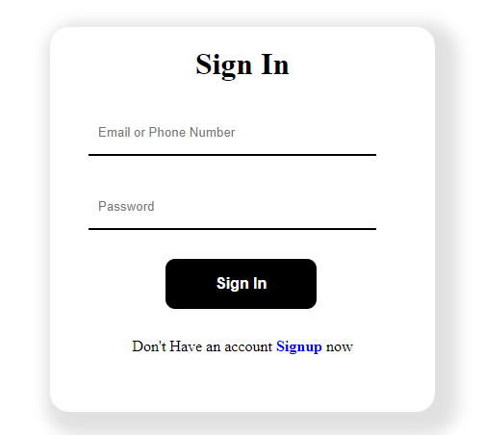

Slide 9
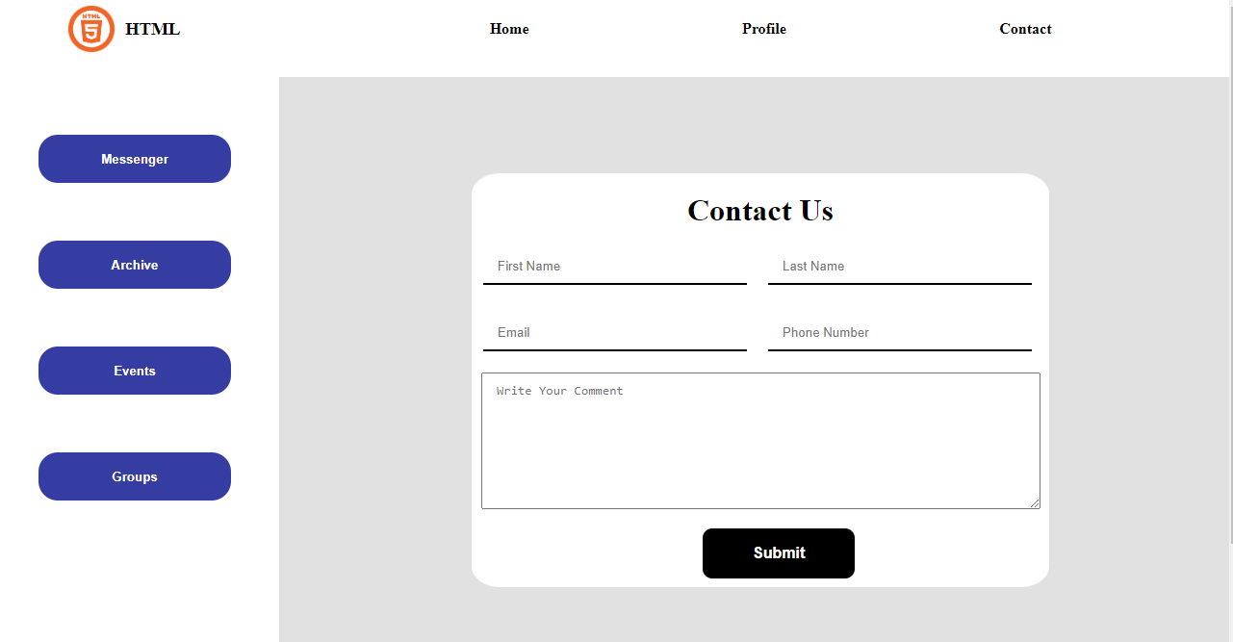
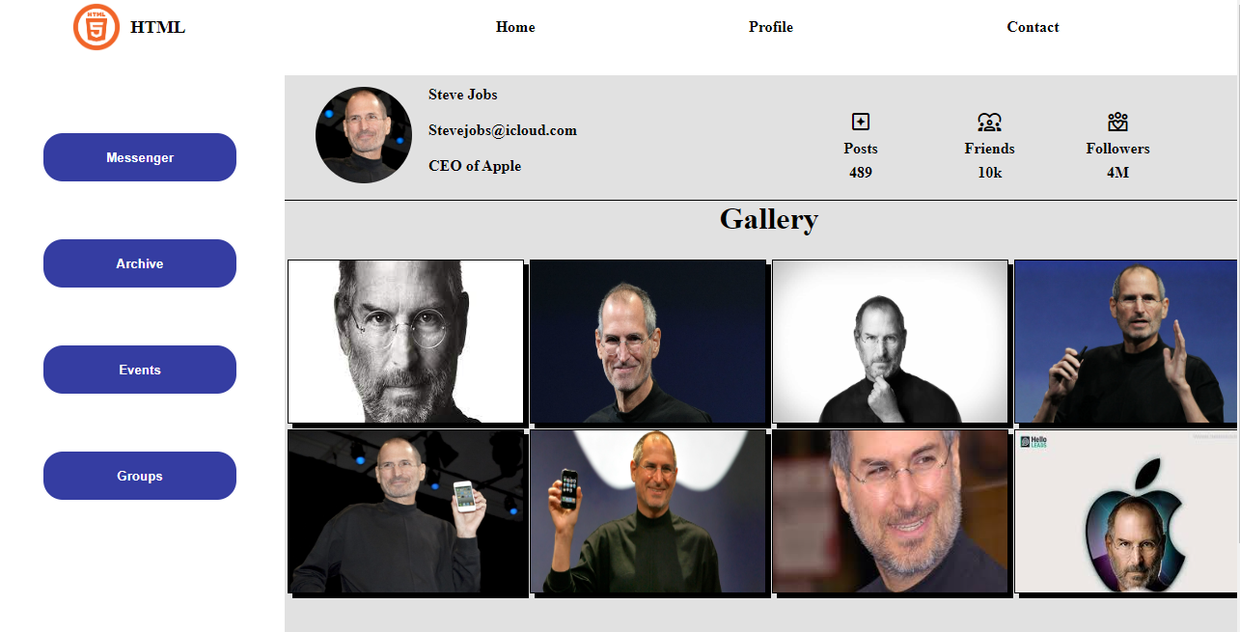
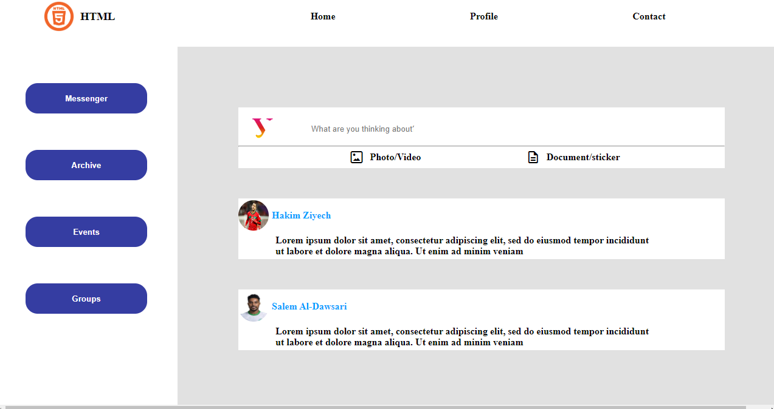

Slide 10


THANK YOU
Notes:
Photo by All Bong on UnsplashPhoto by Samuel Zeller on Unsplash

